Slide 1
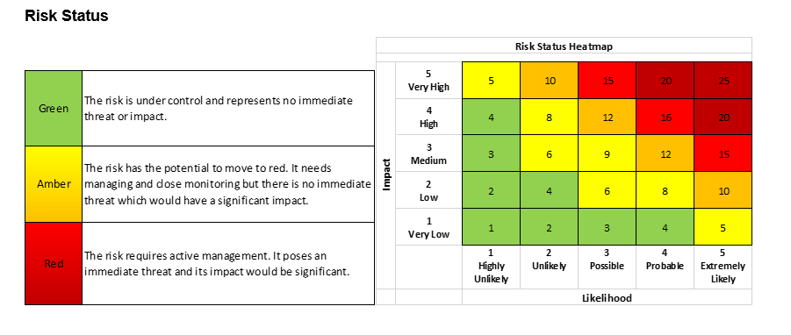
Risk Scoring: Impact
 | Finance | Compliance | Safety | Service Delivery | Reputation | People*
1 Very Low | Minor loss <0.5% of operating budget | Trivial, very short-term single non-compliance. | Insignificant injury (no intervention). | Negligible impact/unnoticed by service users. | Insignificant damage. | Negligible impact on morale and satisfaction.
2 Low | Small loss 0.5 - 1% of operating budget | Small, single, short-term non-compliance. | Minor injury (local intervention). | Small impact/small inconvenience. | Minor or very short-term damage. | Small or short-term impact on morale and satisfaction.
3 Medium | Moderate loss 1 - 2% of operating budget | Sustained single or a few short-term non-compliances. | Moderate injury (professional intervention). | Medium level impact/moderate inconvenience. | Moderate or short-term to medium-term damage. | Medium or short-term to medium-term impact on morale and satisfaction.
4 High | Significant loss 2 - 10% of operating budget | Multiple, sustained non-compliances. | Major injury (hospital stay). | Significant impact/serious inconvenience. | Major or medium to long-term damage. | Major or medium to long-term impact on morale and satisfaction.
5 Very High | Substantial loss >10% of operating budget | Multiple, long-term, significant non-compliances. | Fatal injury. | Substantial/complete service failure. | Substantial or sustained damage. | Substantial or sustained impact on morale and satisfaction.
*The people impact applies to both retention and recruitment of staff and students.
Risk Scoring: Likelihood
 | Probability
1 - Highly Unlikely | Less than 10%
2 - Unlikely | 10-24%
3 - Possible | 25-49%
4 - Probable | 50-74%
5 - Extremely Likely | More than 75%

Slide 2
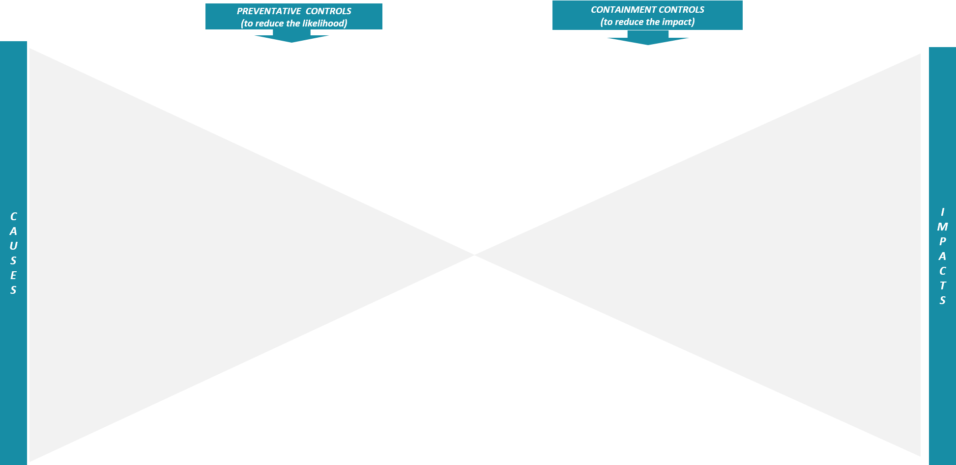
Risk Title/Description
Identify and list possible causes that might lead to the risk event happening.
Identify and list controls that are in place or could be put in place to reduce the likelihood of the risk event occurring.
Identify and list controls that are in place or could be put in place to reduce the impact of the risk.
For example, ‘Appropriate buildings and contents insurance cover in place’ would be a containment control as it would limit the financial impact on the institution.
FINANCIAL
List possible financial impacts (e.g. loss of fee income or financial penalties).
E.g. Fire not detected quickly enough.
For example, for the cause shown to the left, then ‘Working smoke alarm system’ could be a preventative control, as it would reduce the likelihood of small fires spreading and causing significant structural damage.
COMPLIANCE
List possible compliance impacts (e.g. failure to comply with requirements of the Office for Students or GDPR).
RISK EVENT
Description of the risk event (e.g. a fire that causes significant structural damage)
SAFETY
List possible safety impacts (e.g. injury to staff or students).
SERVICE DELIVERY
List possible impacts on service delivery (e.g. unable to deliver teaching)
REPUTATIONAL
List possible reputational impacts (e.g. negative press coverage)
PEOPLE
List possible impacts on people (e.g. decreased staff morale or student satisfaction).
Notes:
Cross-refer with priorities framework

